Slide 1
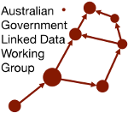
AGLDWG AGM 2024 Project Presentations
Multiple AGLDWG Members

Slide 2
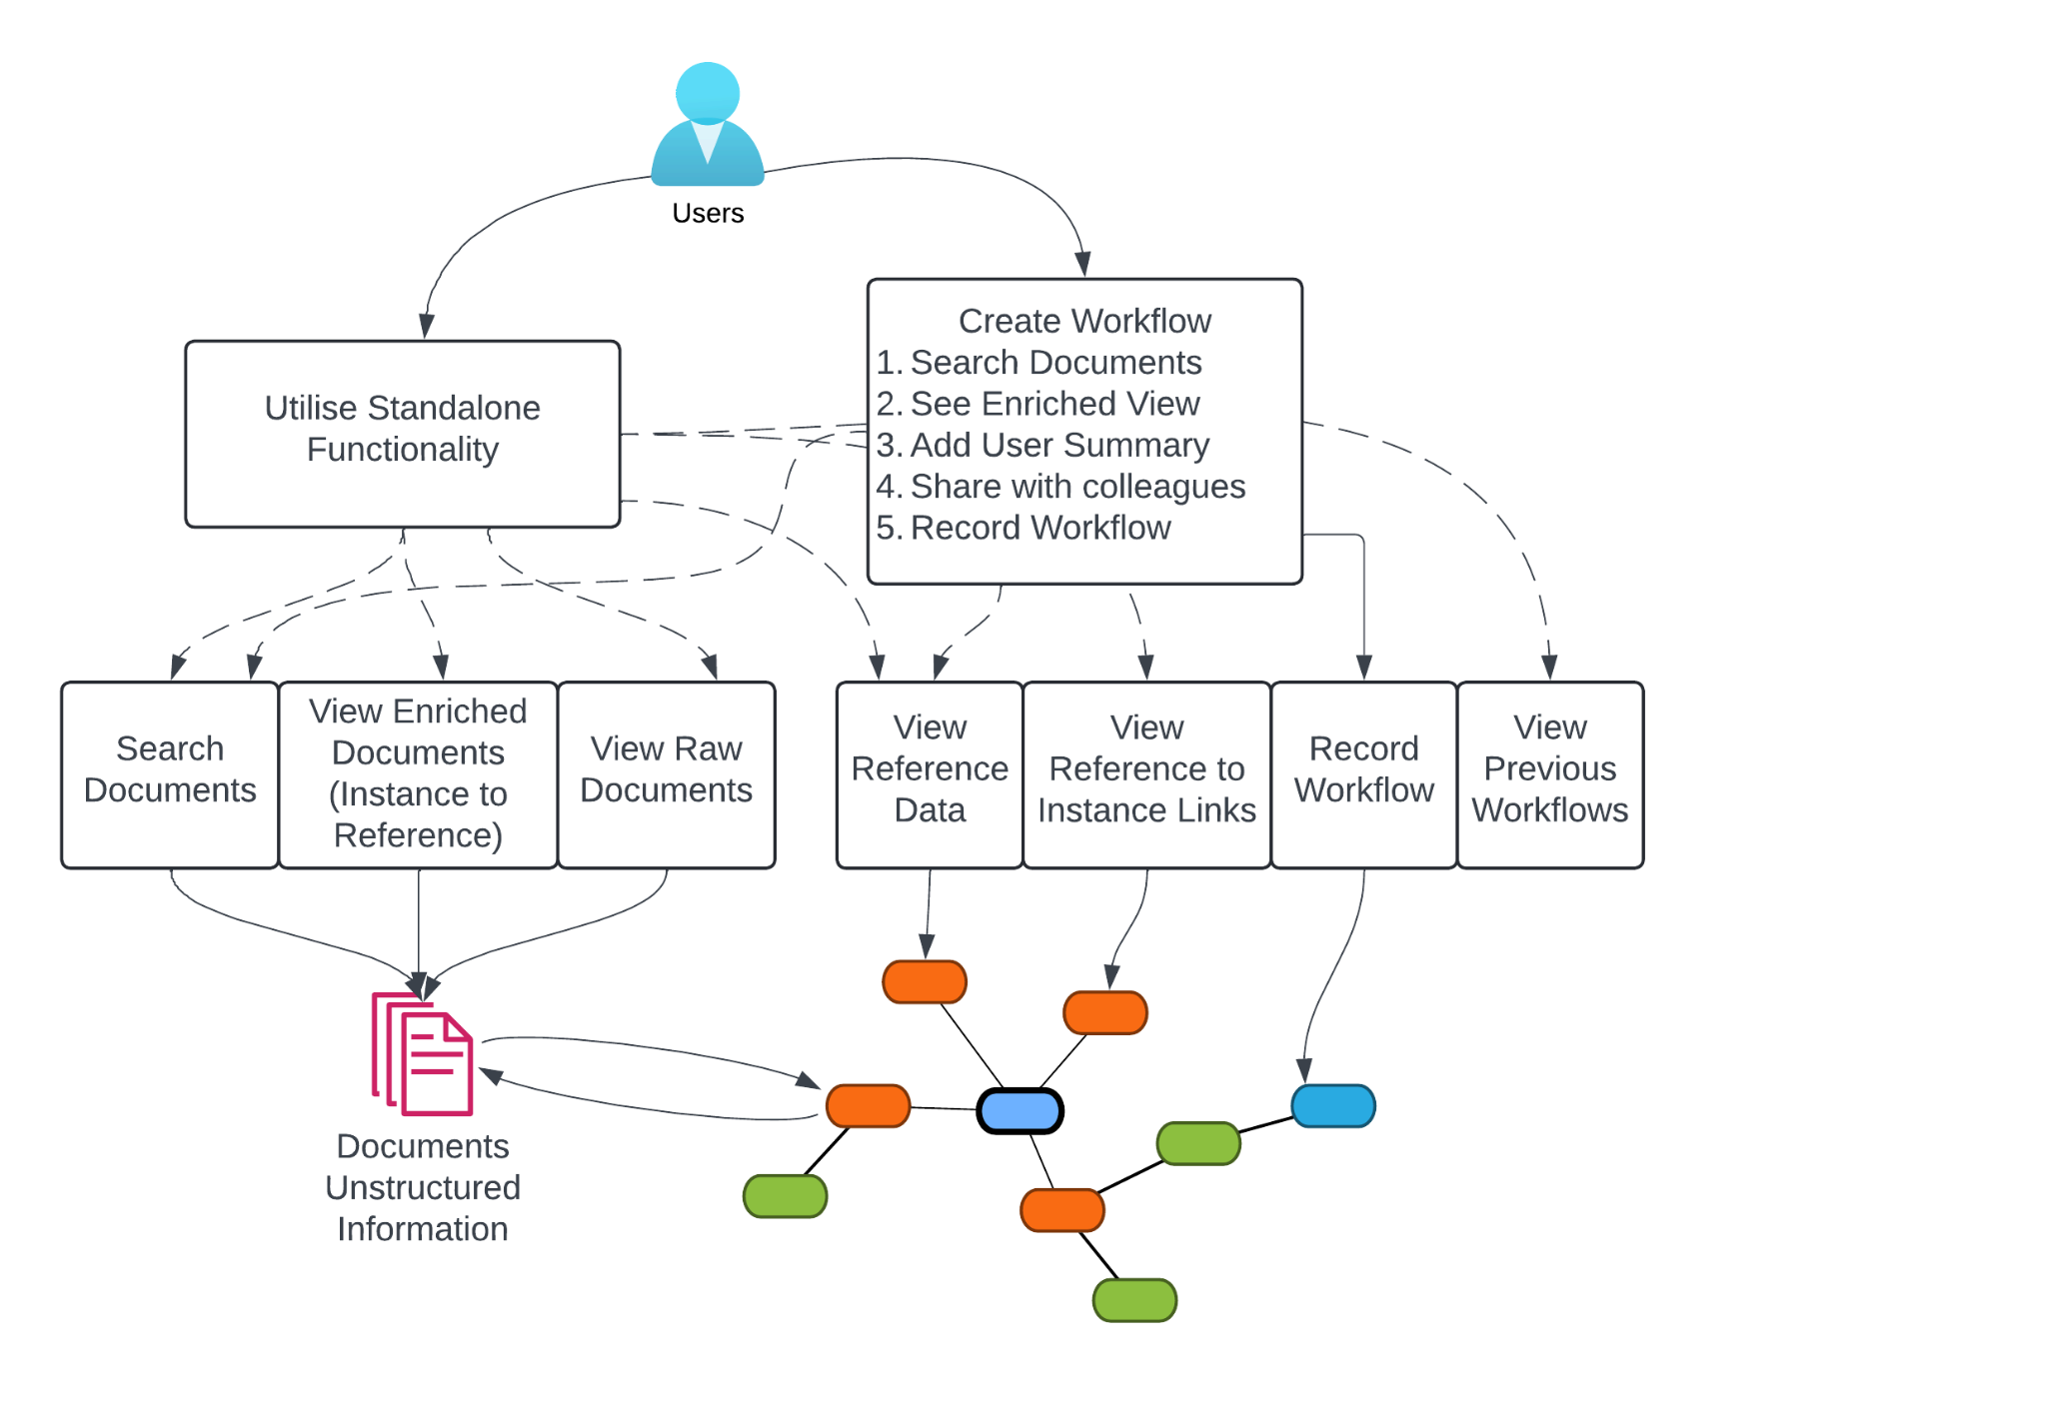
Knowledge Graphs + AI
Speaker: David Habgood, KurrawongAI

Slide 3
KG use and LD ETL
Speaker: Byran Gan, Geological Survey of WA

Slide 4

FIAF Knowledge Graph
Speaker: Paul Duchesne, NFSA

Slide 5
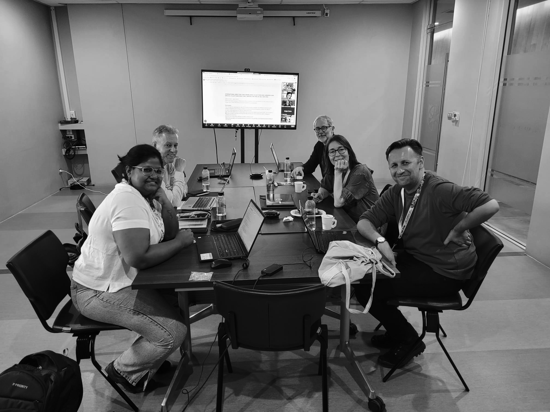

Slide 6
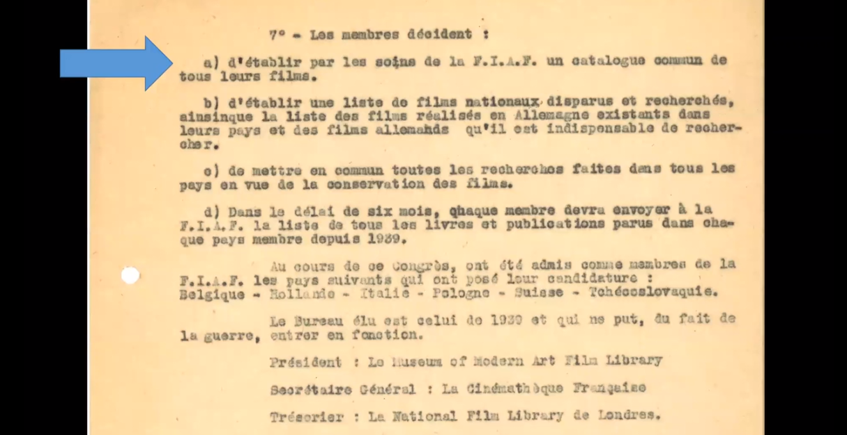
Ultimate Goal
Executive decision from Paris FIAF Congress, 1946:

Slide 7
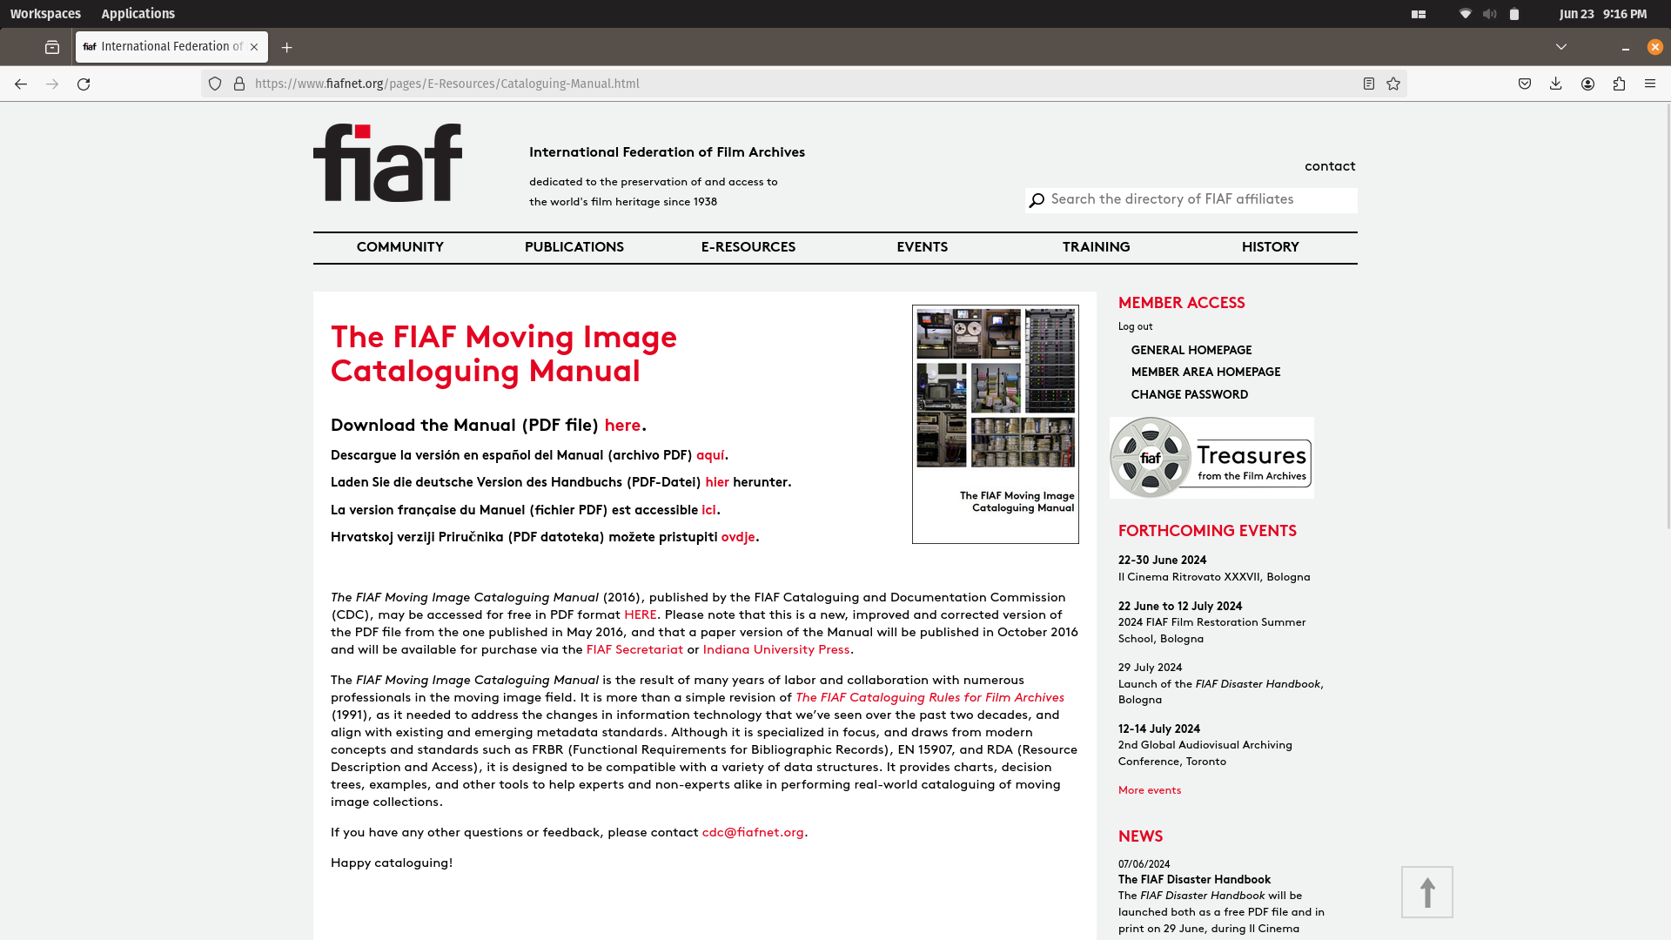

Slide 8
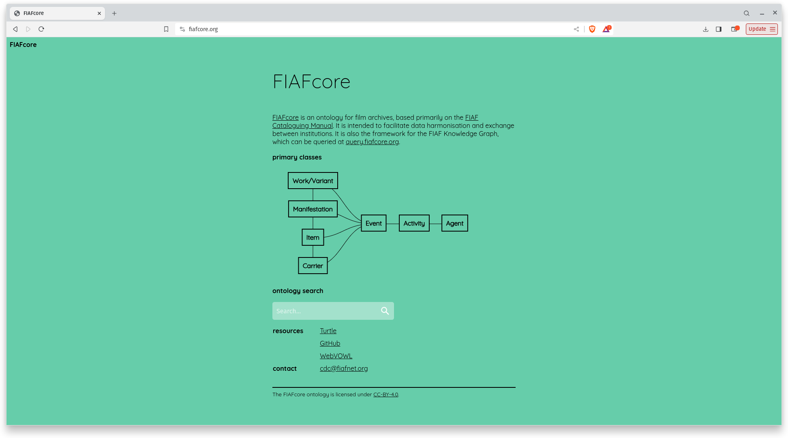

Slide 9
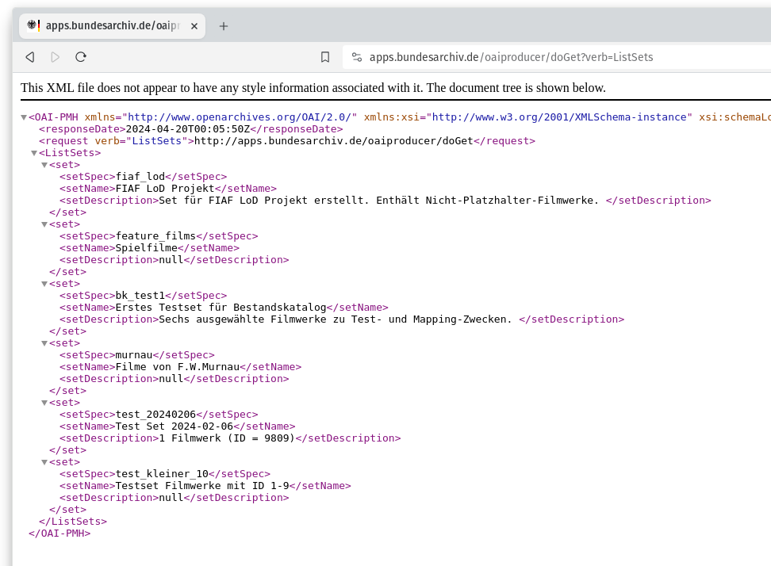

Slide 10
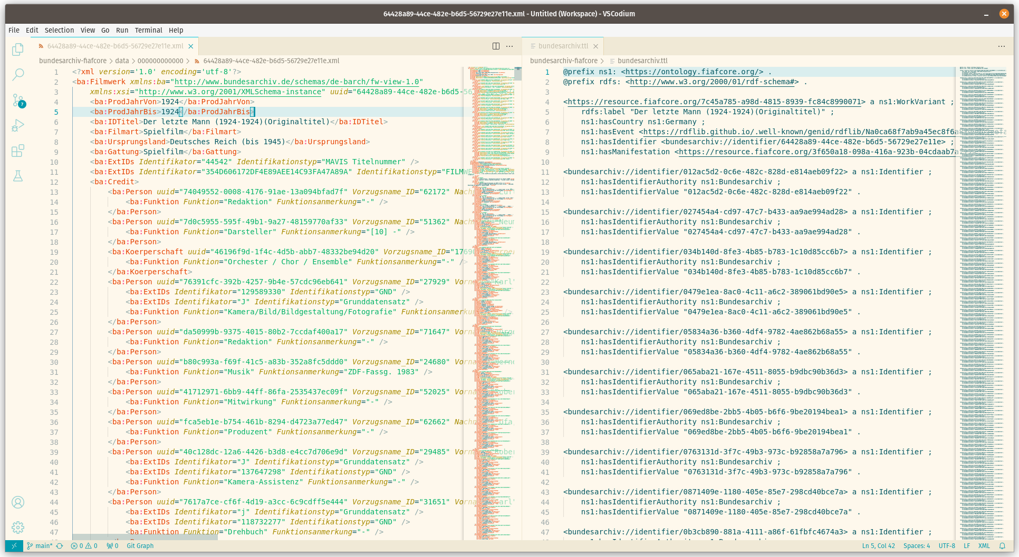

Slide 11
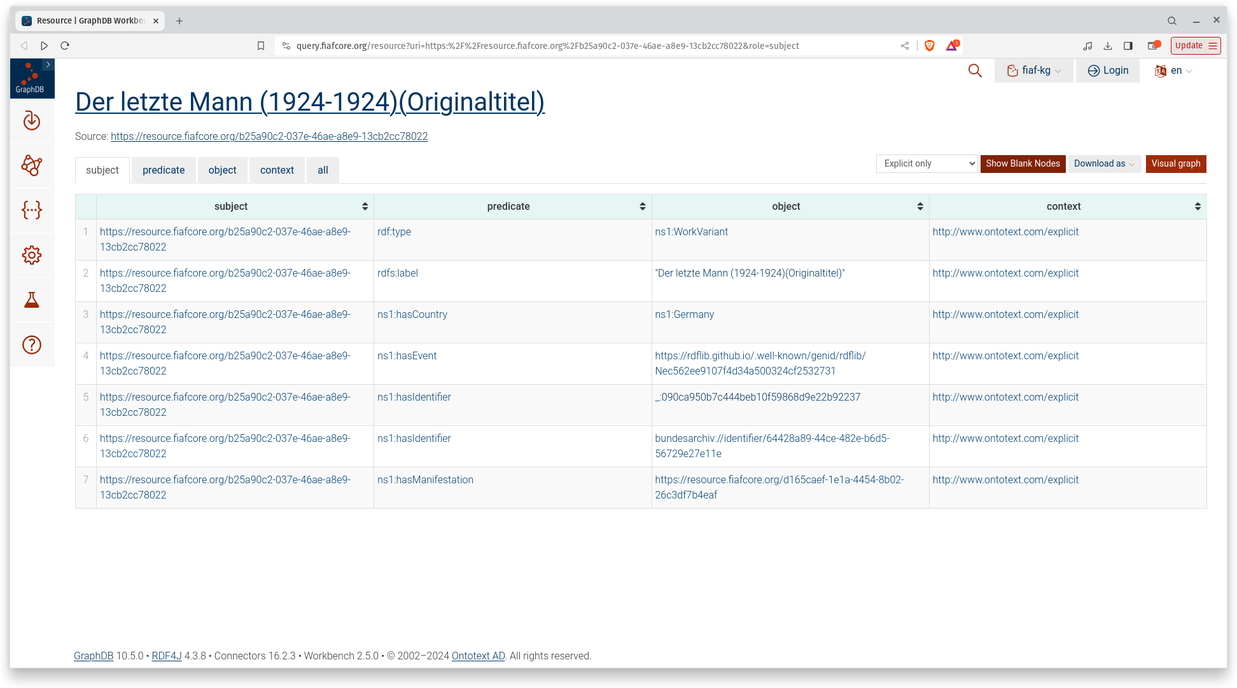

Slide 12
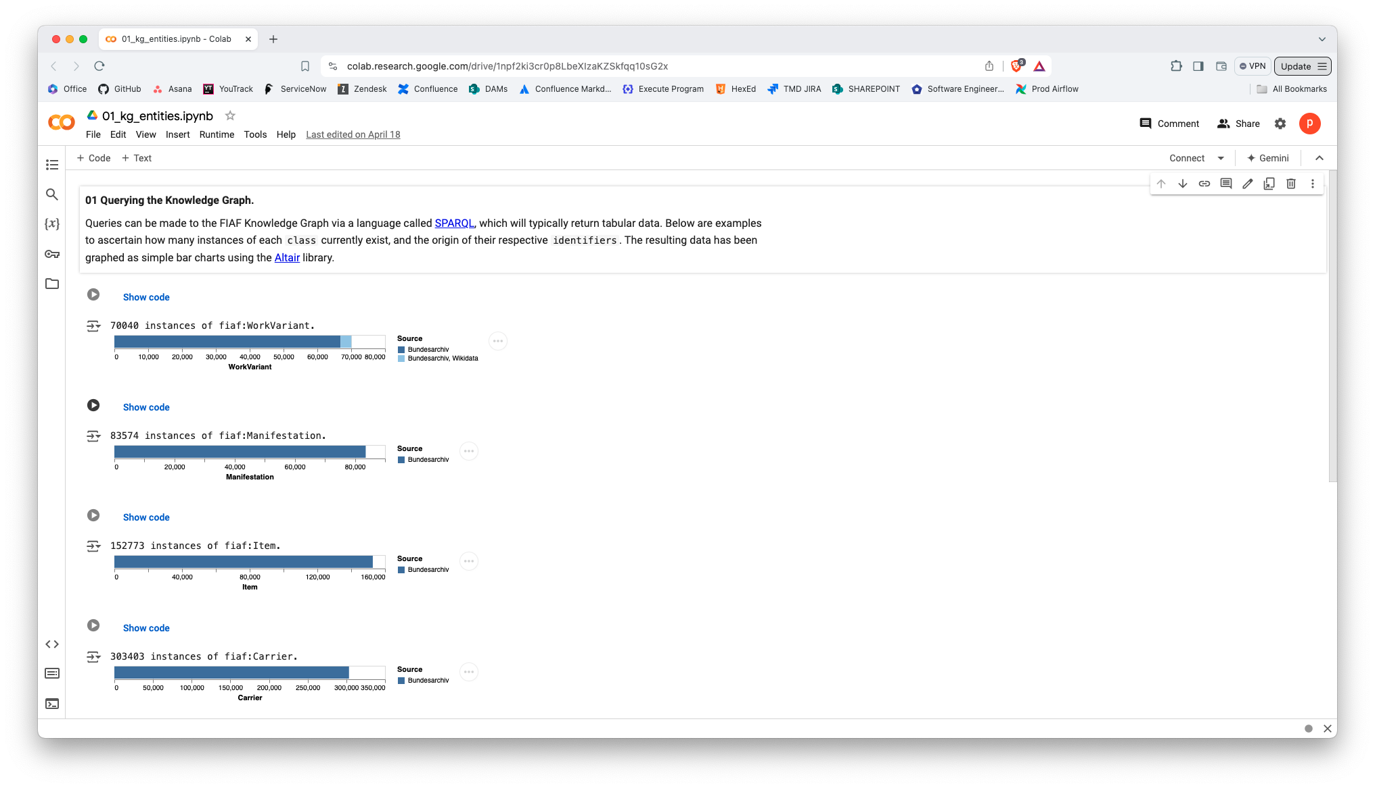

Slide 13
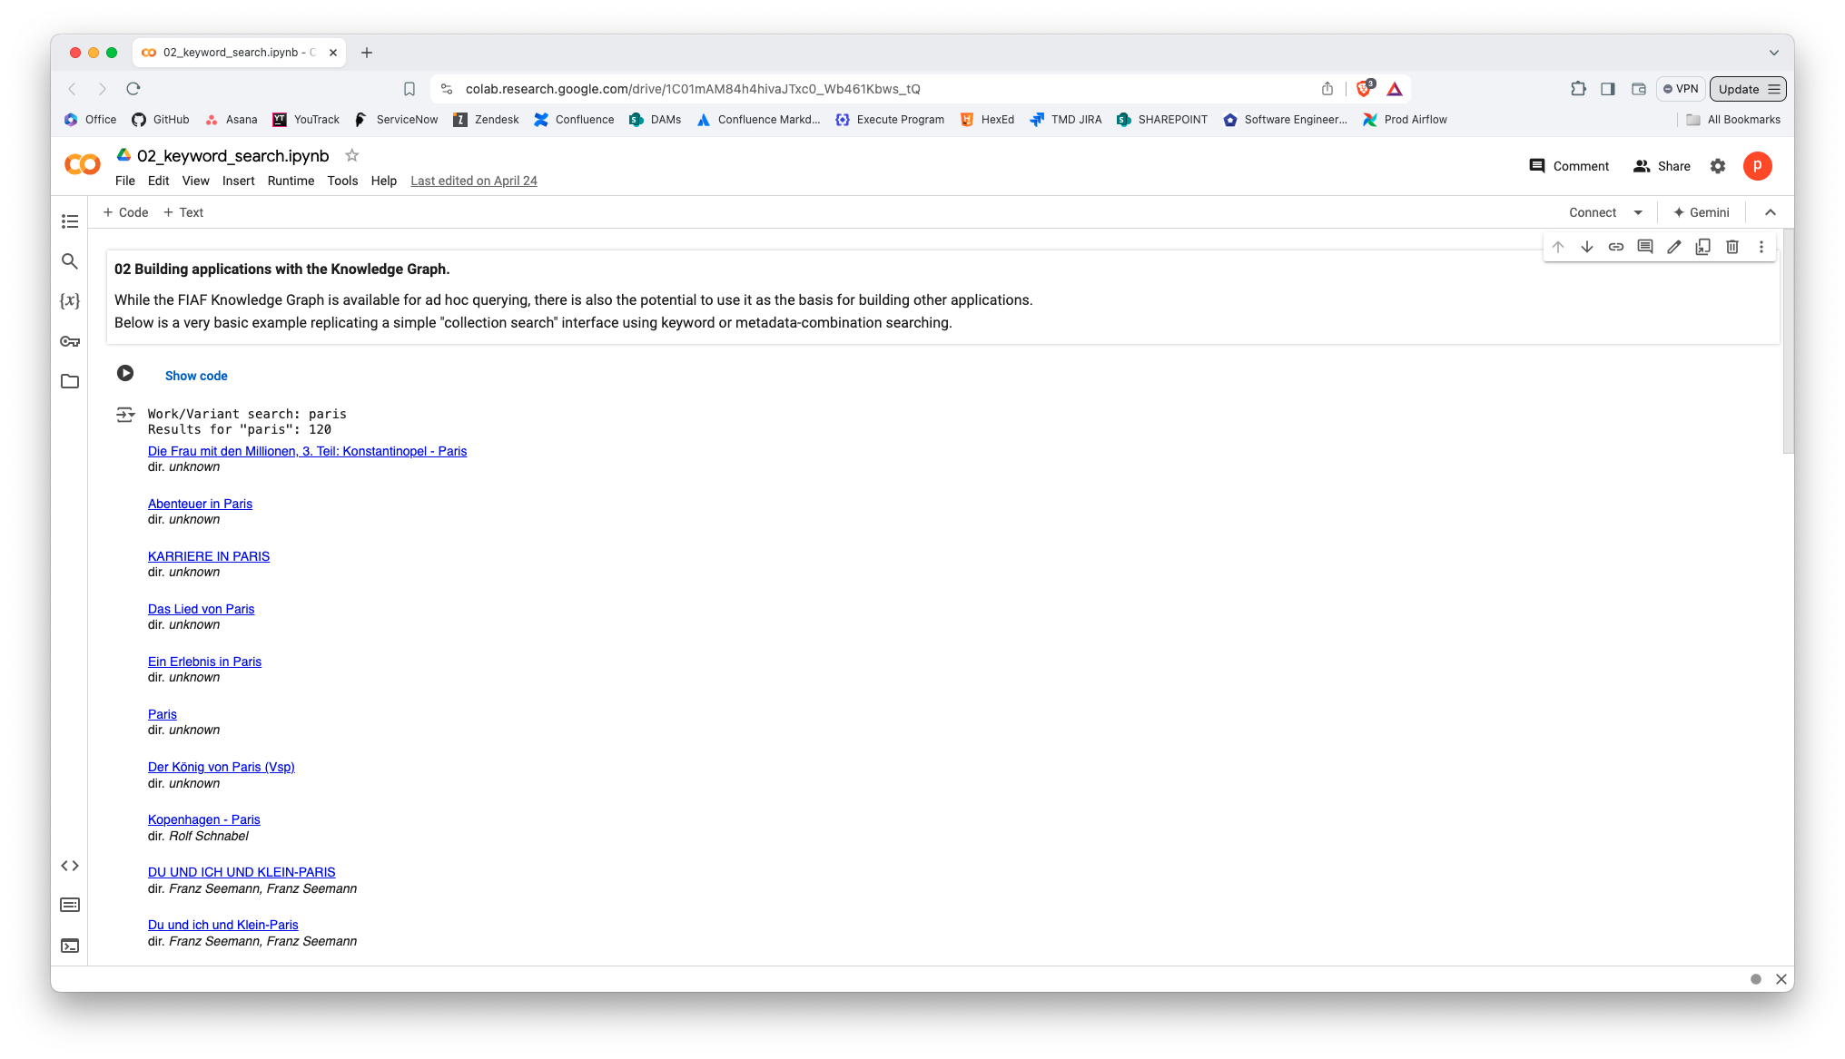

Slide 14
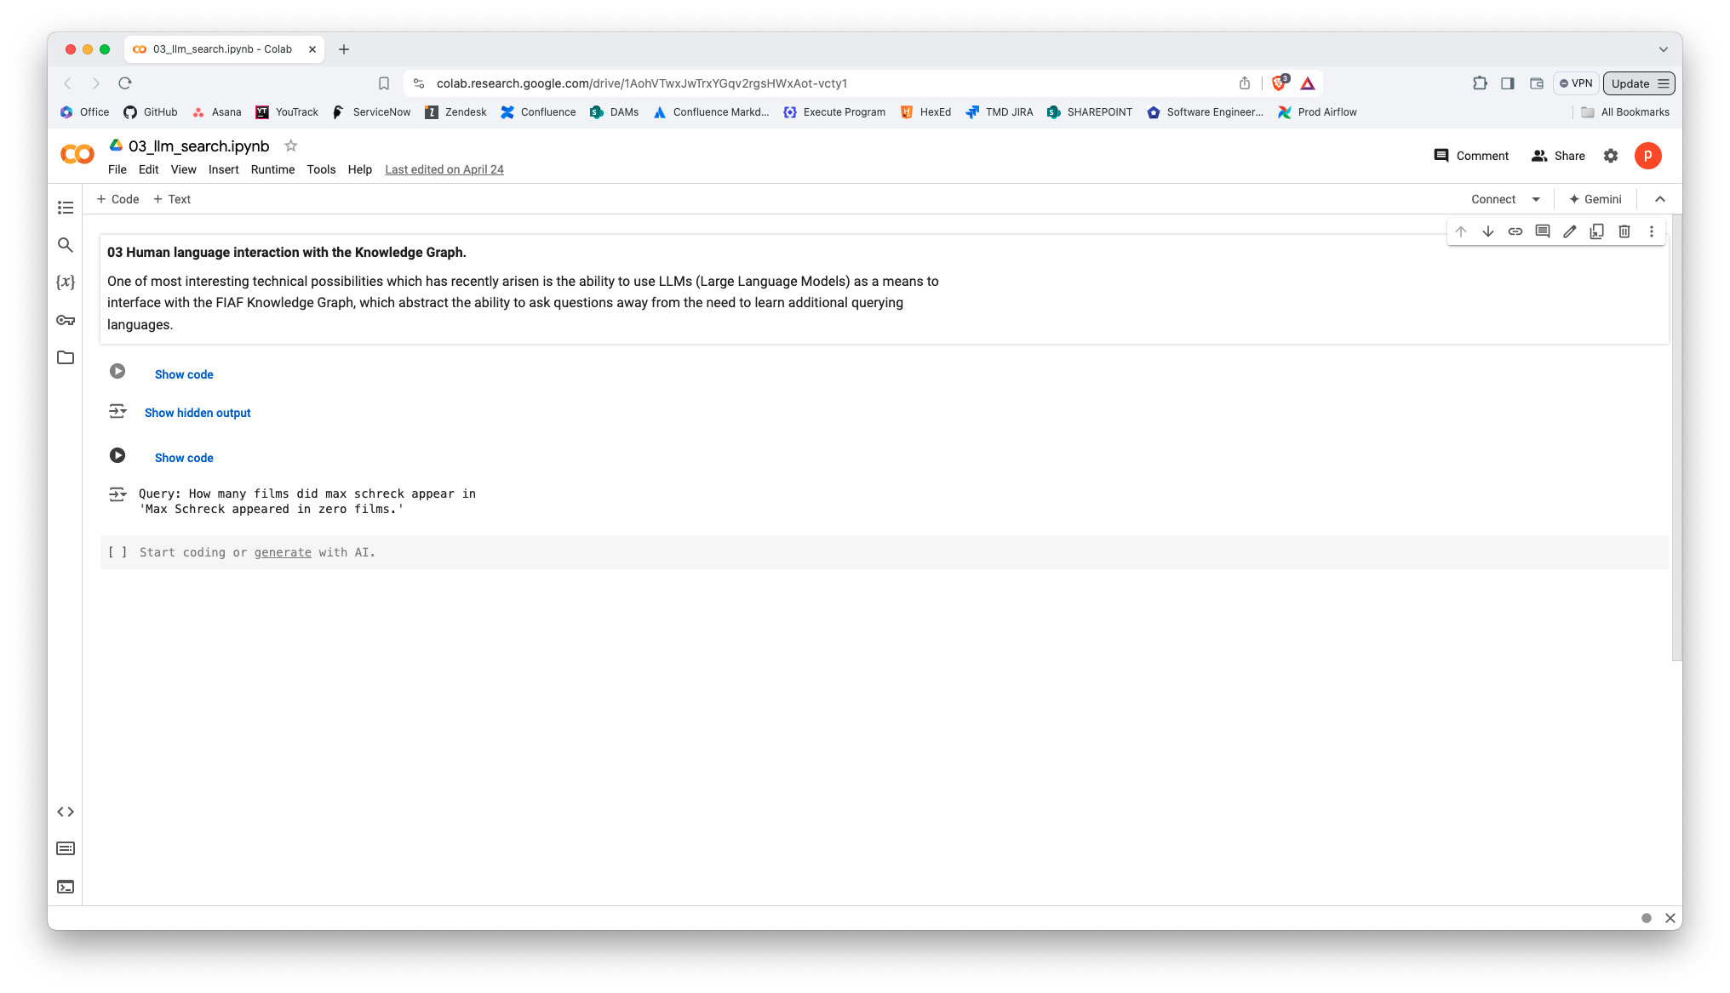

Slide 15
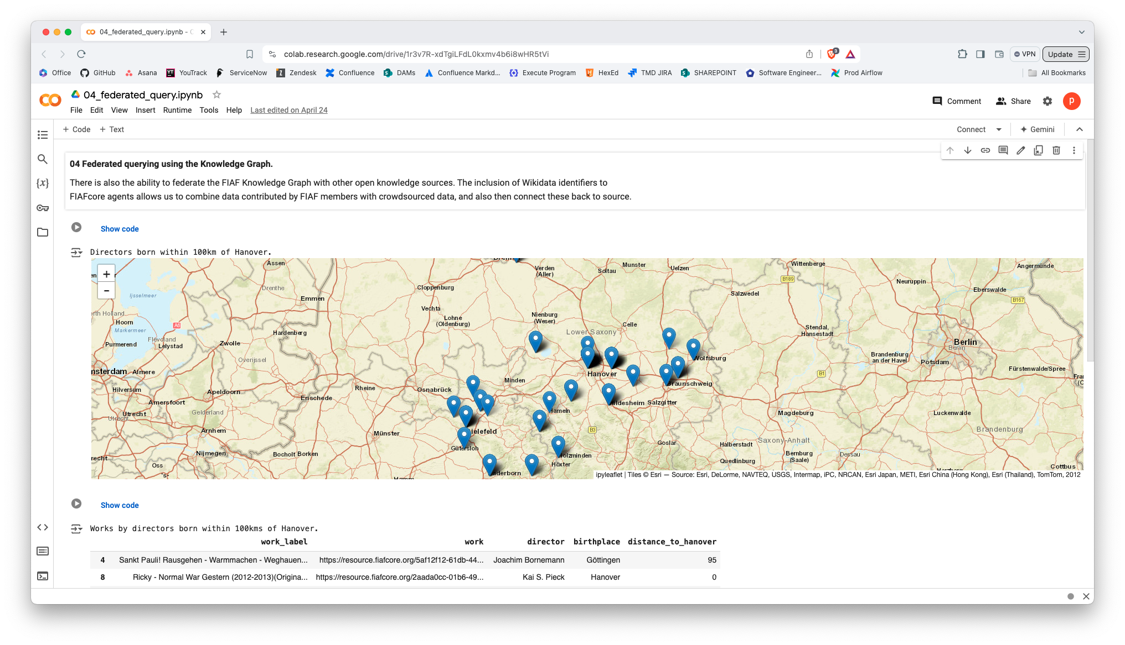

Slide 16
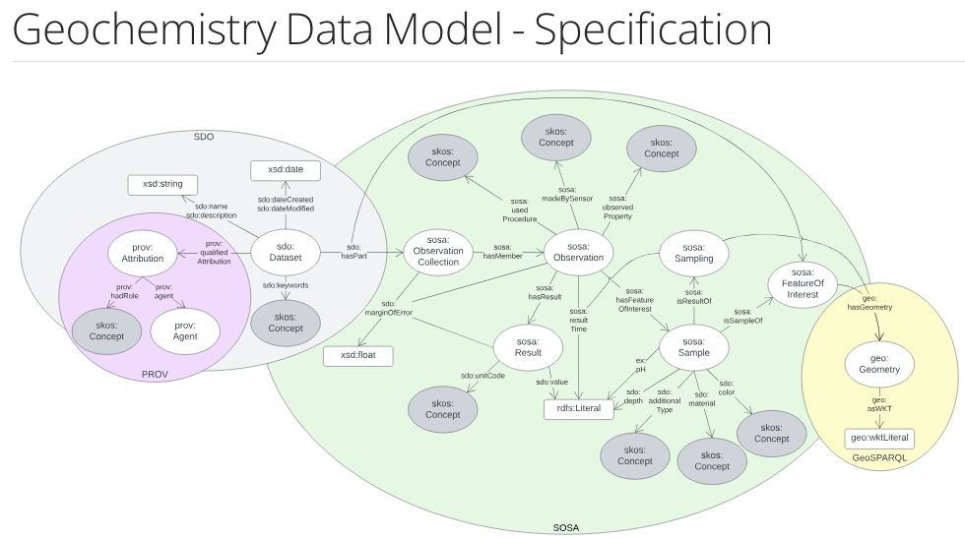
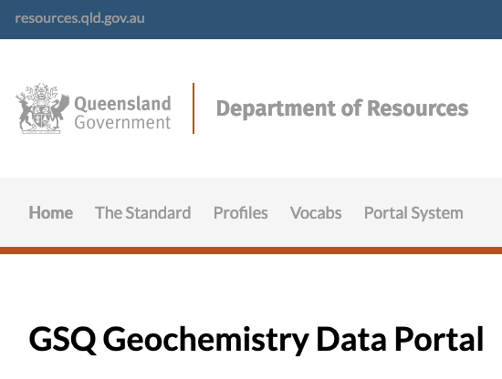
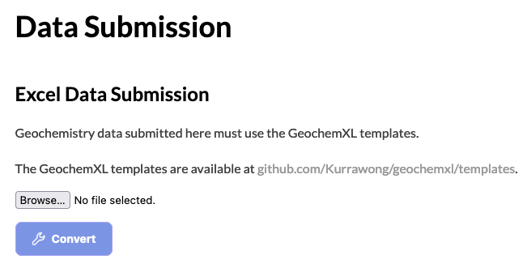
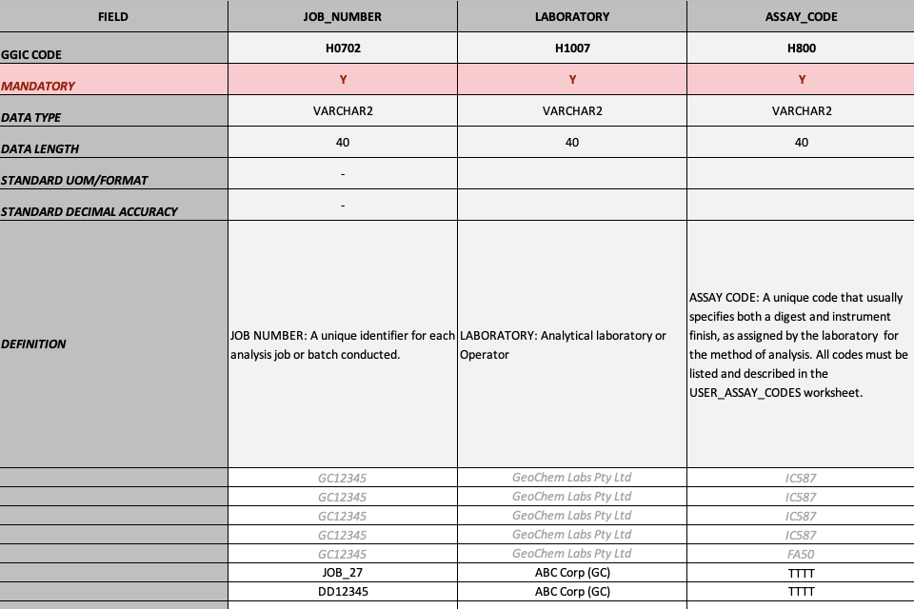
National GeoChem Data Harmonisation via LD
Speaker: Rob Chatterjee, Geological Survey of Qld

Slide 17
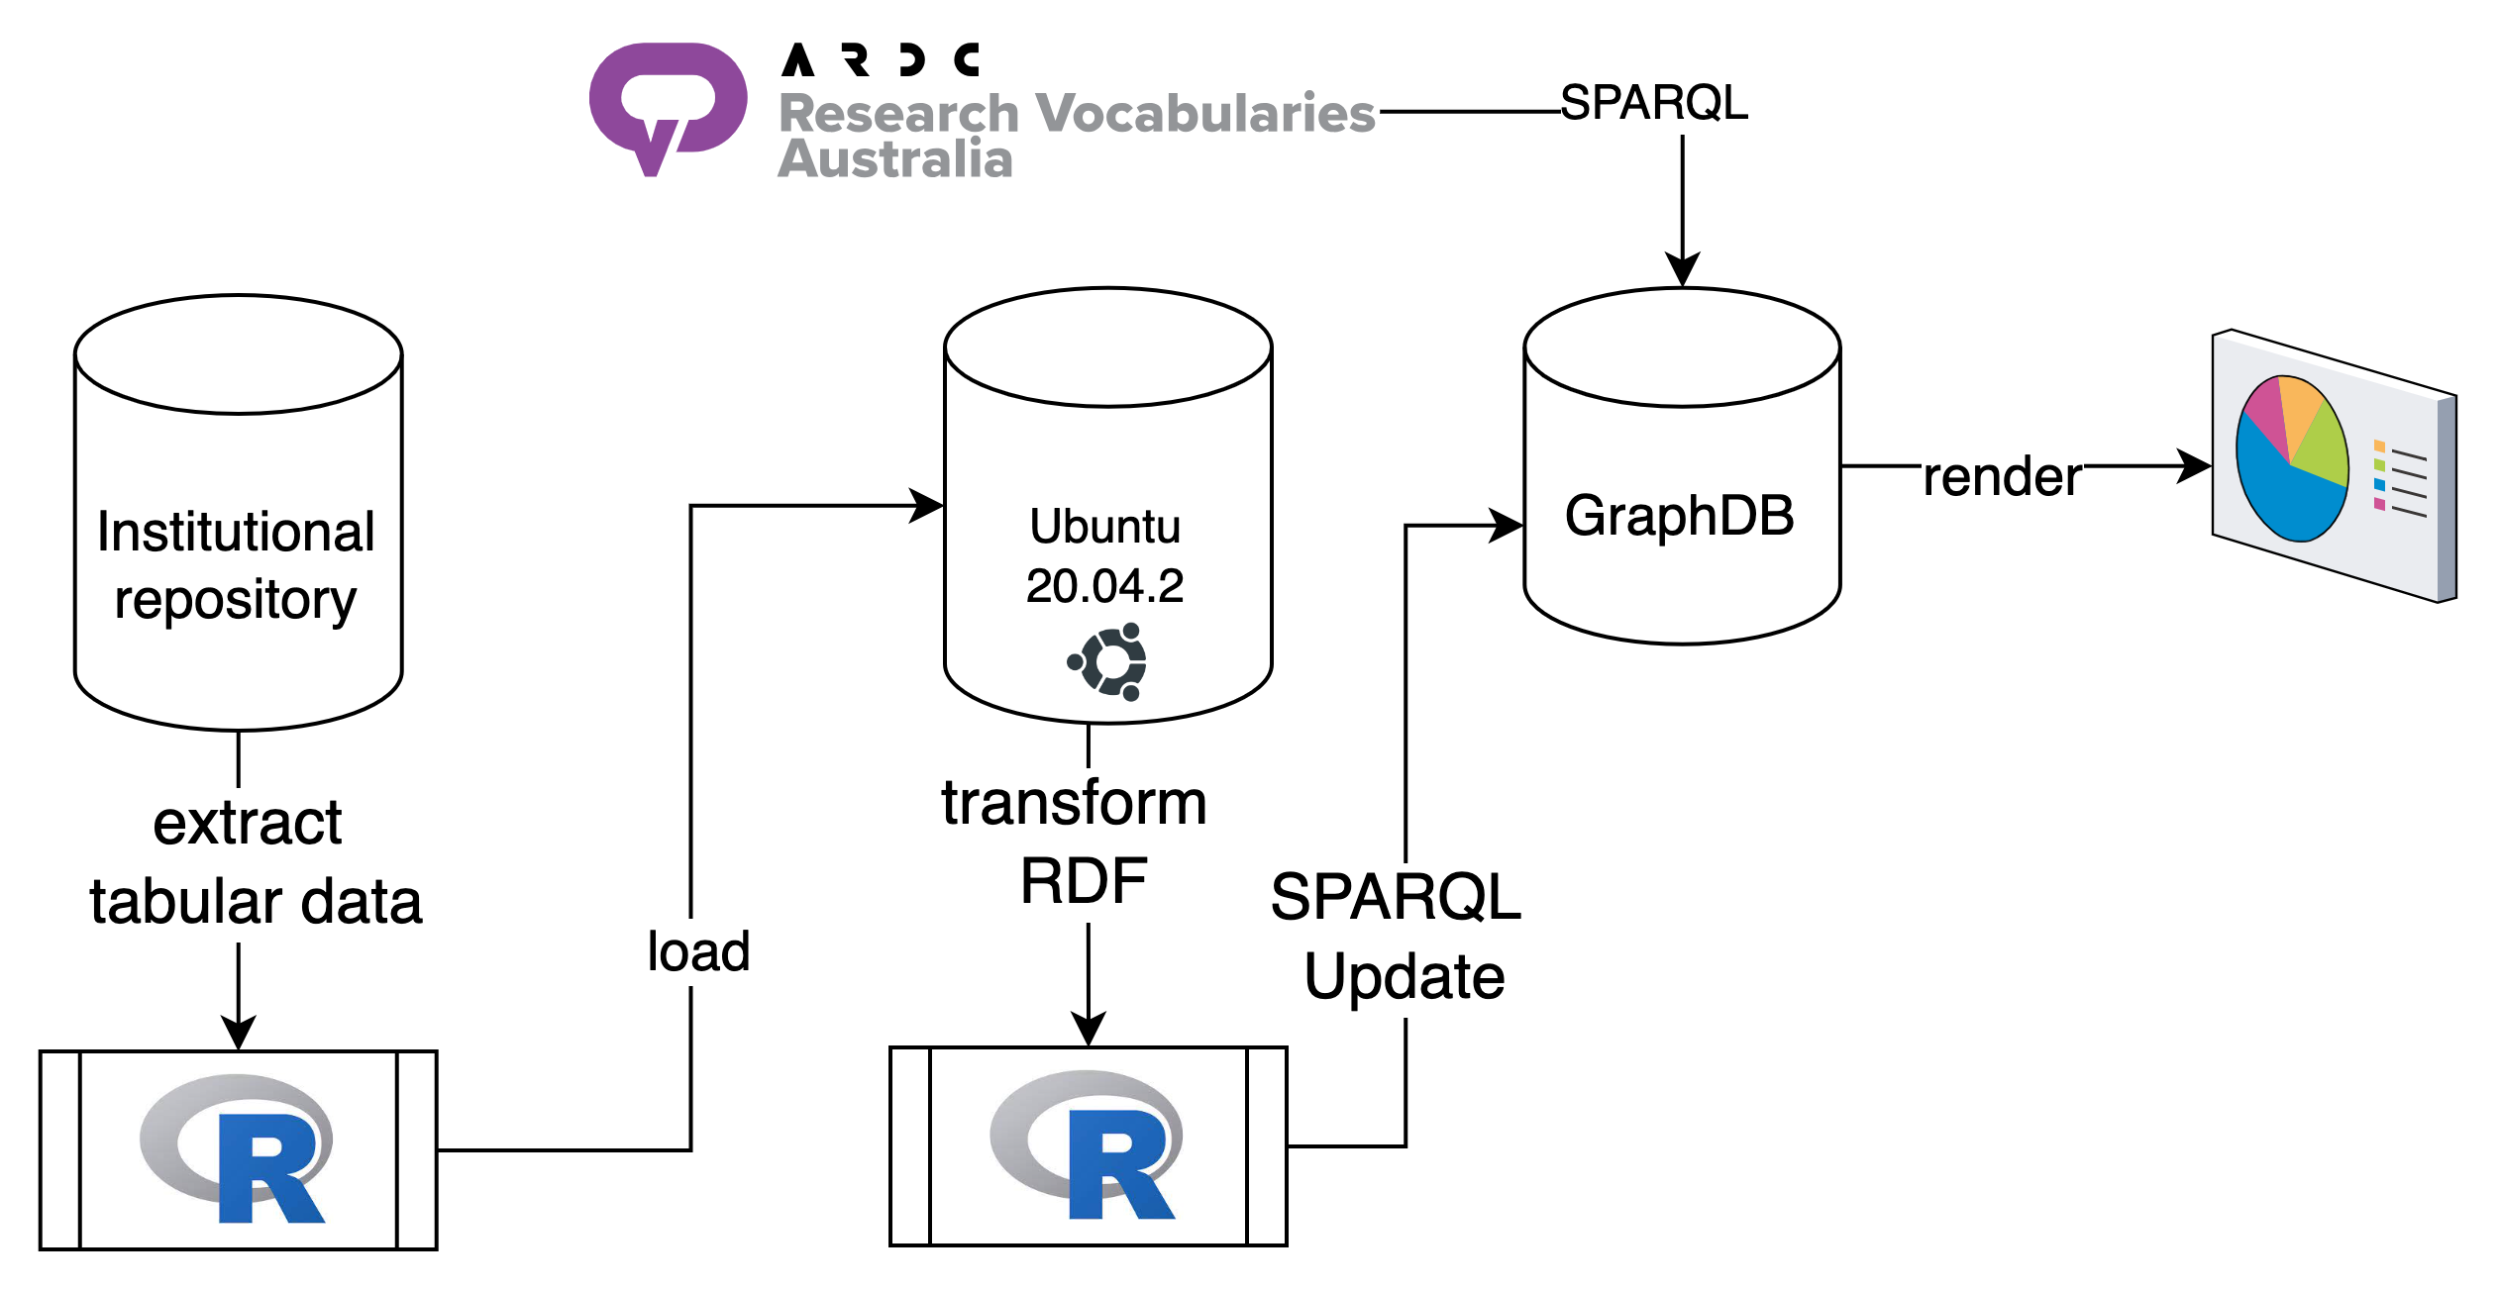
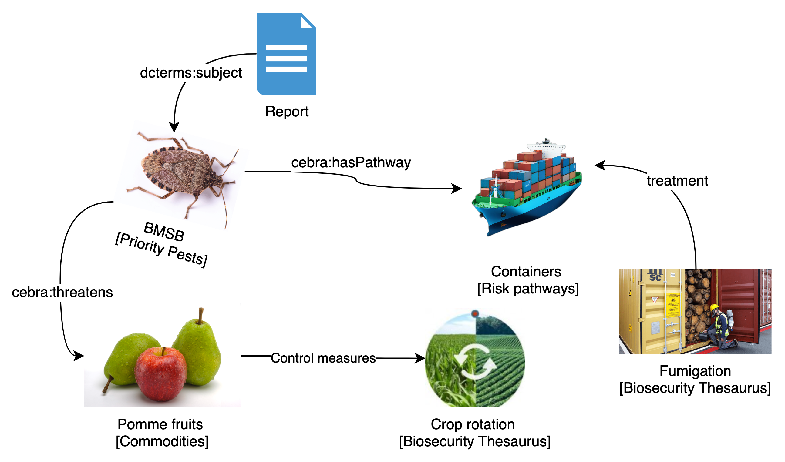
CEBRA Biosecurity Portal
Speaker: Les Kneebone, Uni Melbourne

Slide 18
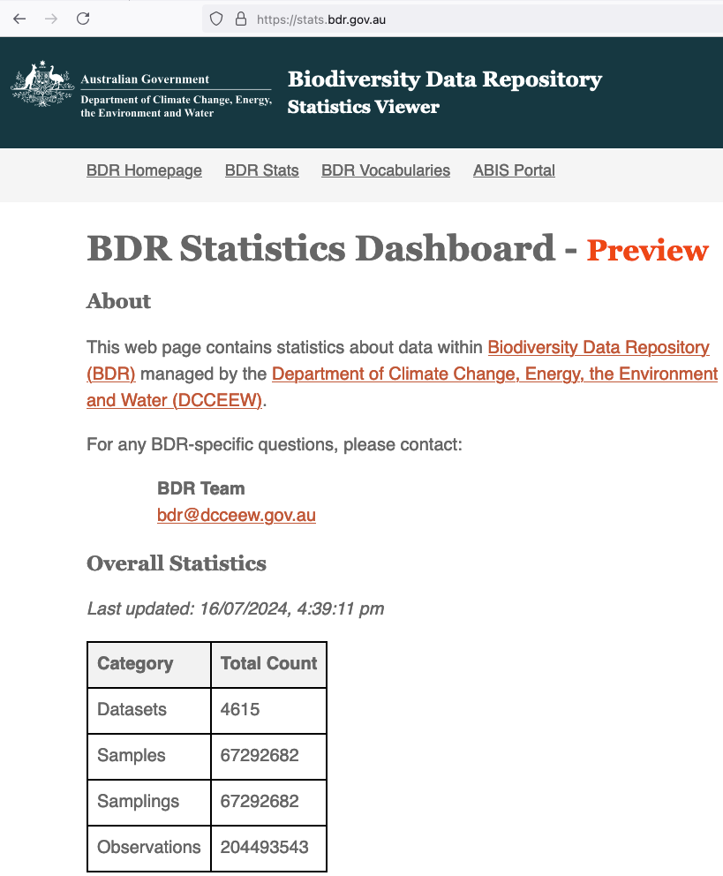
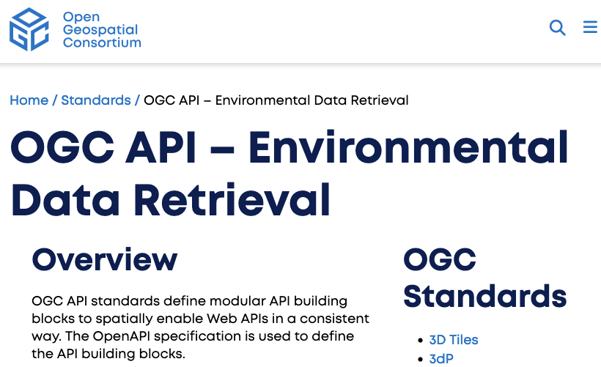
Biodiversity Data Repository
Speaker: Ashley Sommer, CSIRO
Soon to be the largest, public-facing, RDF dataset in Australia. Multiple standard APIs for access

Slide 19
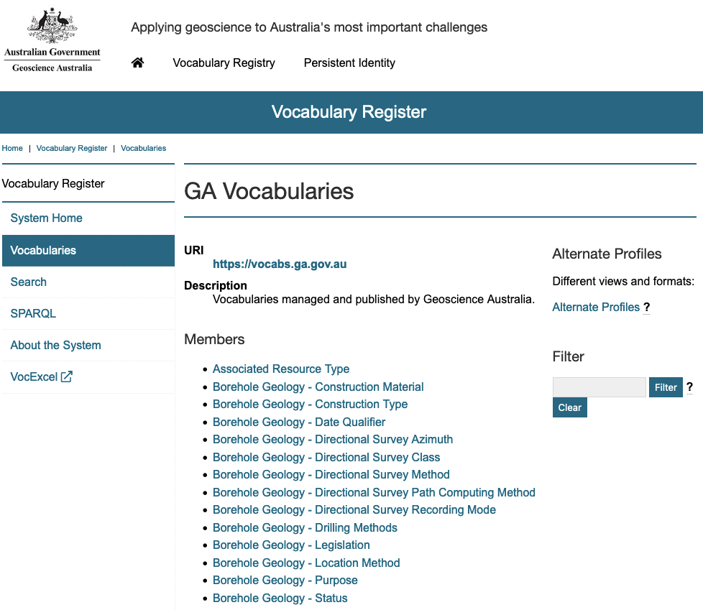
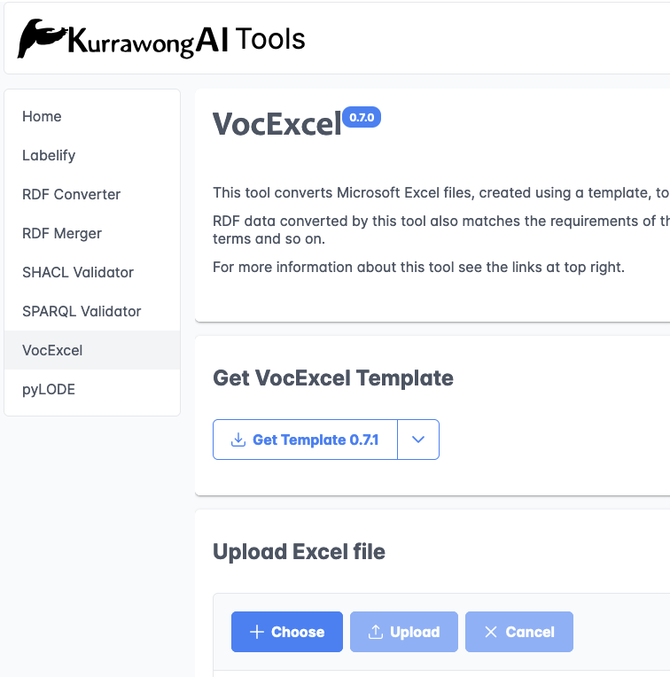
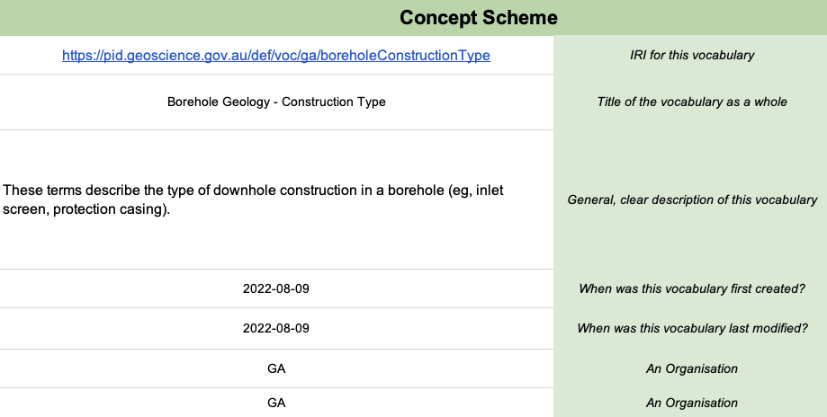
Geoscience Australia vocabs
Speaker: Margie Smith, GA

Slide 20
Office of the National Data Commissioner (ONDC)
Australian Government Linked Data Working Group (AGLDWG) Annual General Meeting
August 2024

Slide 21



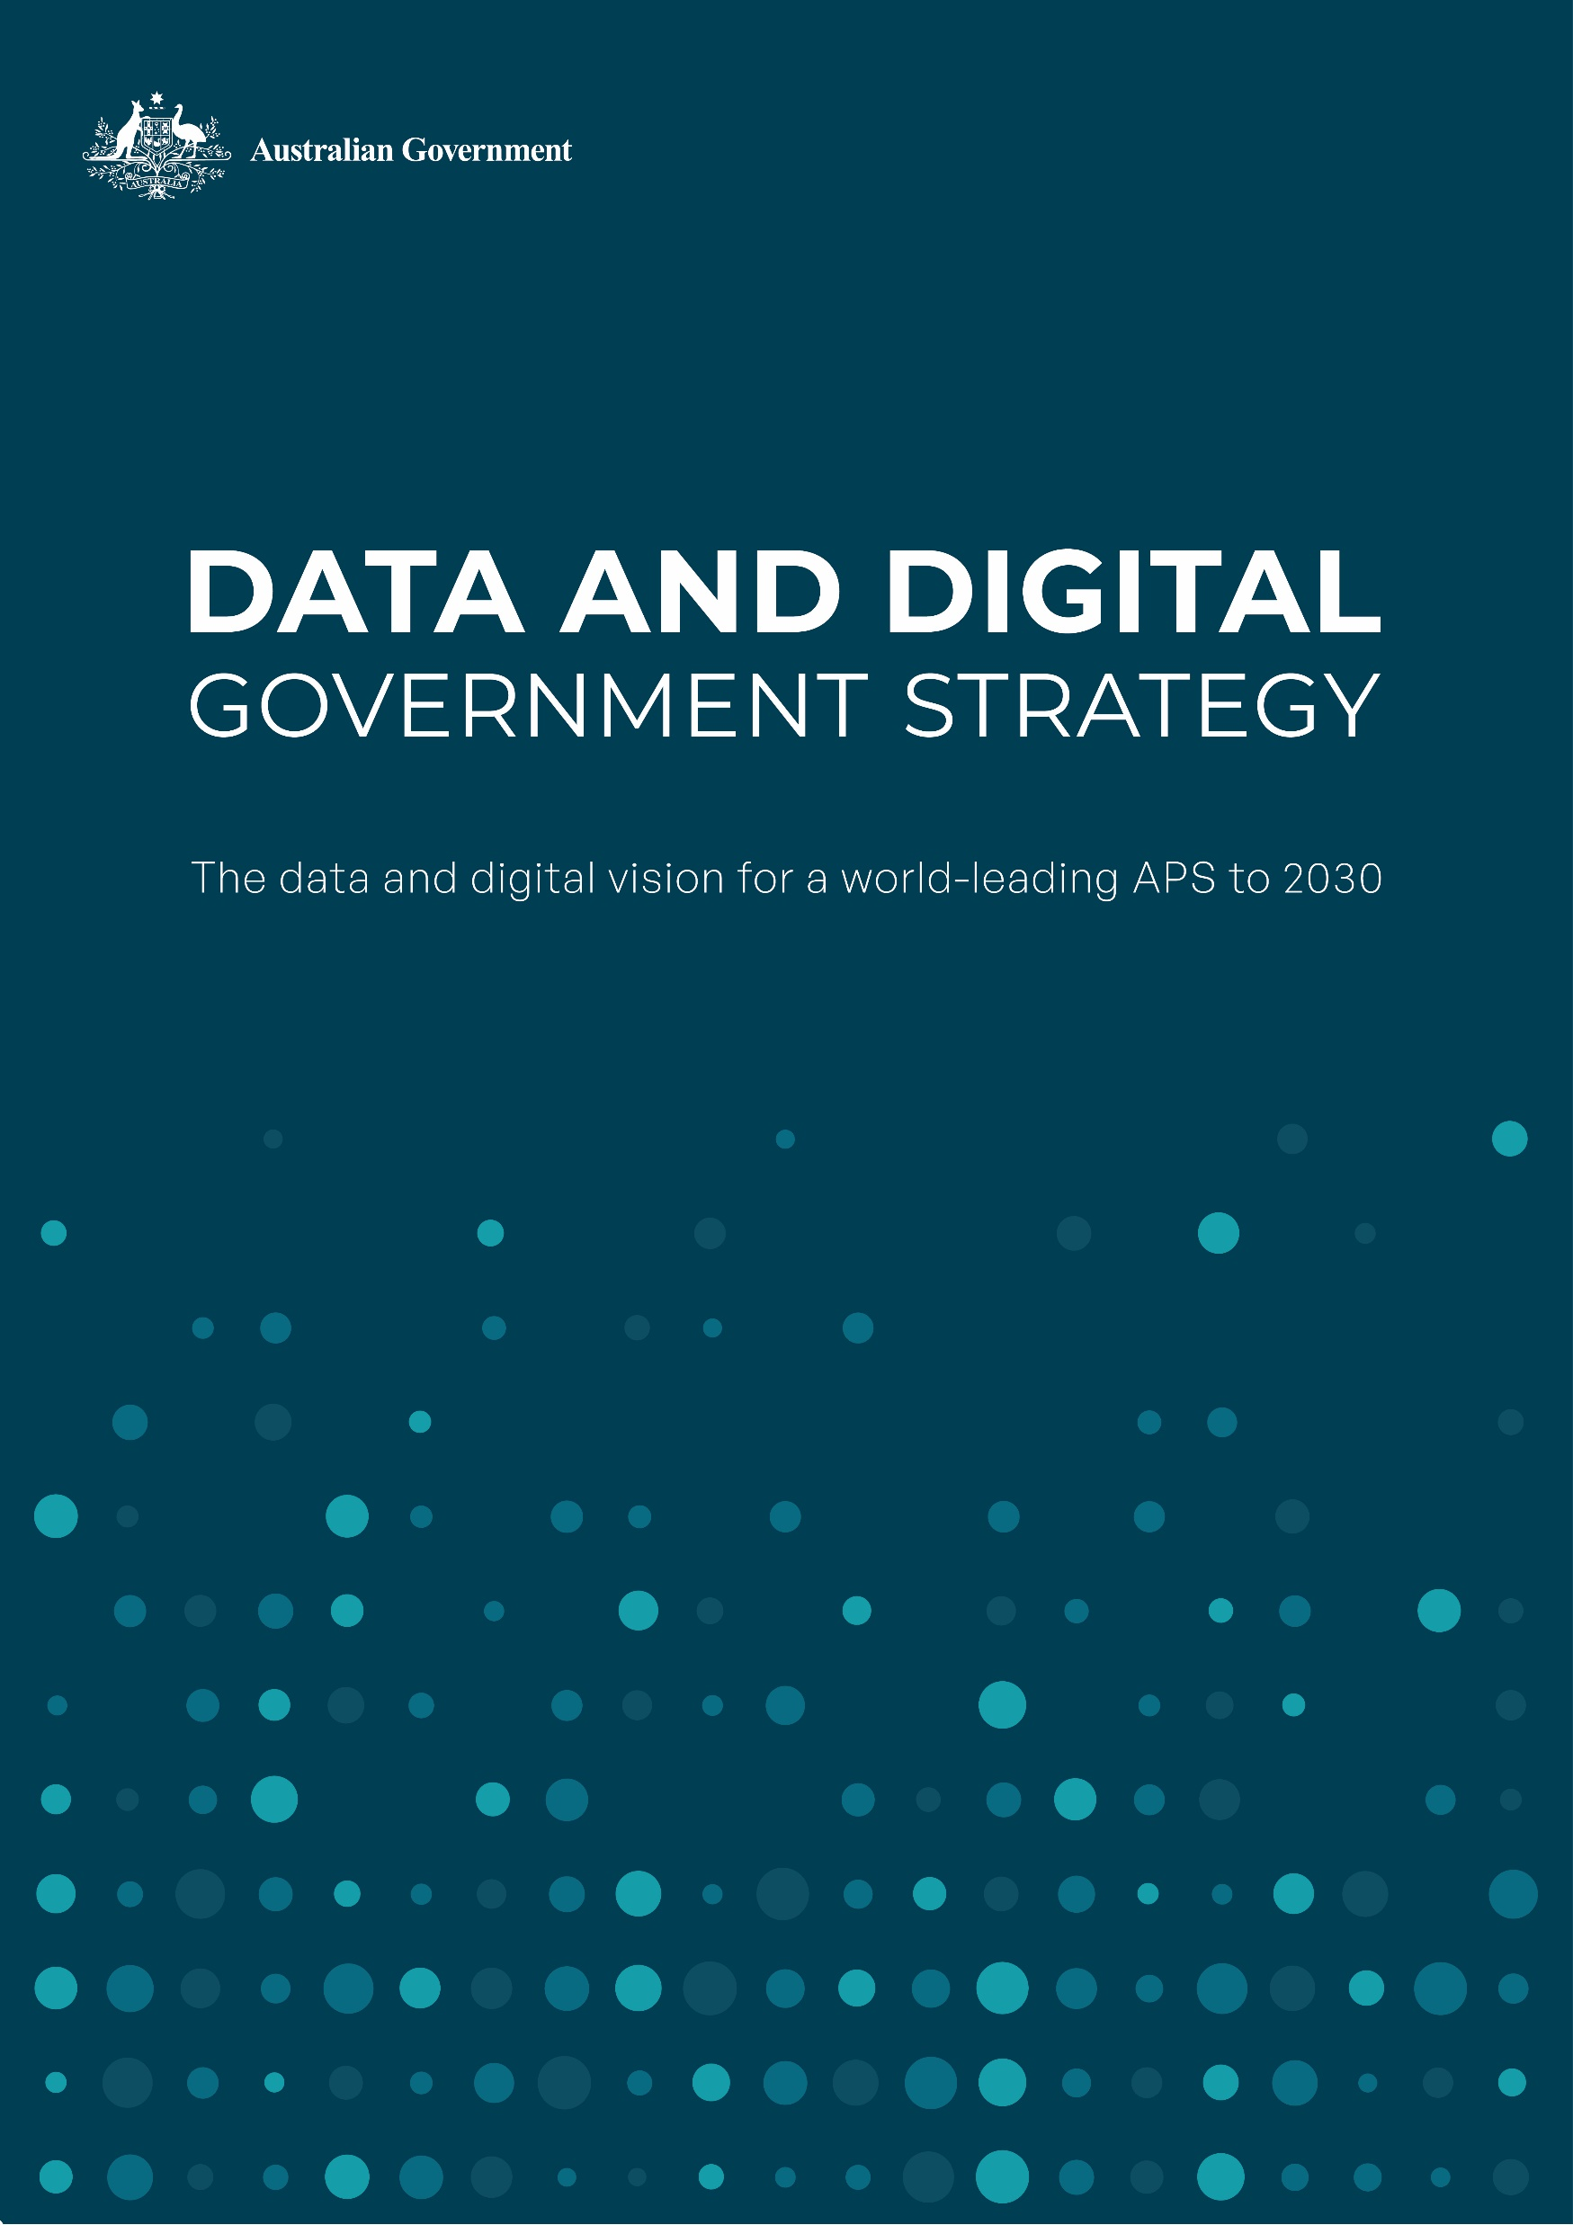


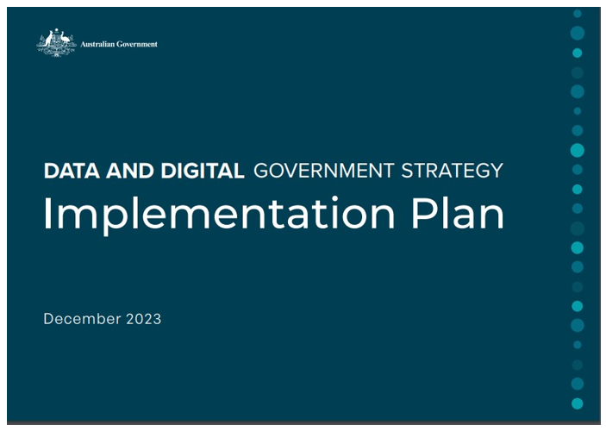




2030 Vision
Strategy Missions
The Australian Government will deliver simple, secure and connected public services for all people and business through world class data and digital capabilities
Delivering for all people and business
Simple and seamless services
Government for the future
Trusted and secure
Data and digital foundations
Enablers
People
Capability
Cyber
Security
Governance
Investment

Slide 22
ONDC Data Programs
Agency
Whole-of-Government
Data Inventory Pilot Program
Australian Government Data Catalogue
Dataplace
Serve the public interest by promoting better availability of public sector data
Enable sharing of public sector data consistent with the Privacy Act and appropriate safeguards
Enhance integrity and transparency in sharing public sector data
Build confidence in the use of public sector data
Establish institutional arrangements for sharing public sector data
Agencies develop their data inventories, uplift their data skills and develop consistent reporting and documentation
Facilitates access to open and restricted government data assets
Data request and agreement service for Australian Government data assets
The Data Inventory Pilot Program (DIPP) established and enhanced data inventories for approximately 23% of Australian Government agencies. These data inventories provided the foundation for the Catalogue.
Australian Government Data Catalogue (the Catalogue) is a public searchable catalogue of government held data assets.
Agencies determine which of their data assets are included in the Catalogue, however, the ONDC encourages agencies to publish their data holdings as it will provide benefits including reduced number of enquiries for data assets that are not owned by the agency.
Dataplace is a new digital platform that makes it easier to request Australian Government data.
The process for sharing and requesting data from the Catalogue is facilitated through Dataplace. It also helps manage the accreditation of organsiations to support them requesting data under the DATA Scheme. Dataplace will also report on Australian Government data sharing activities to the public.

Slide 23





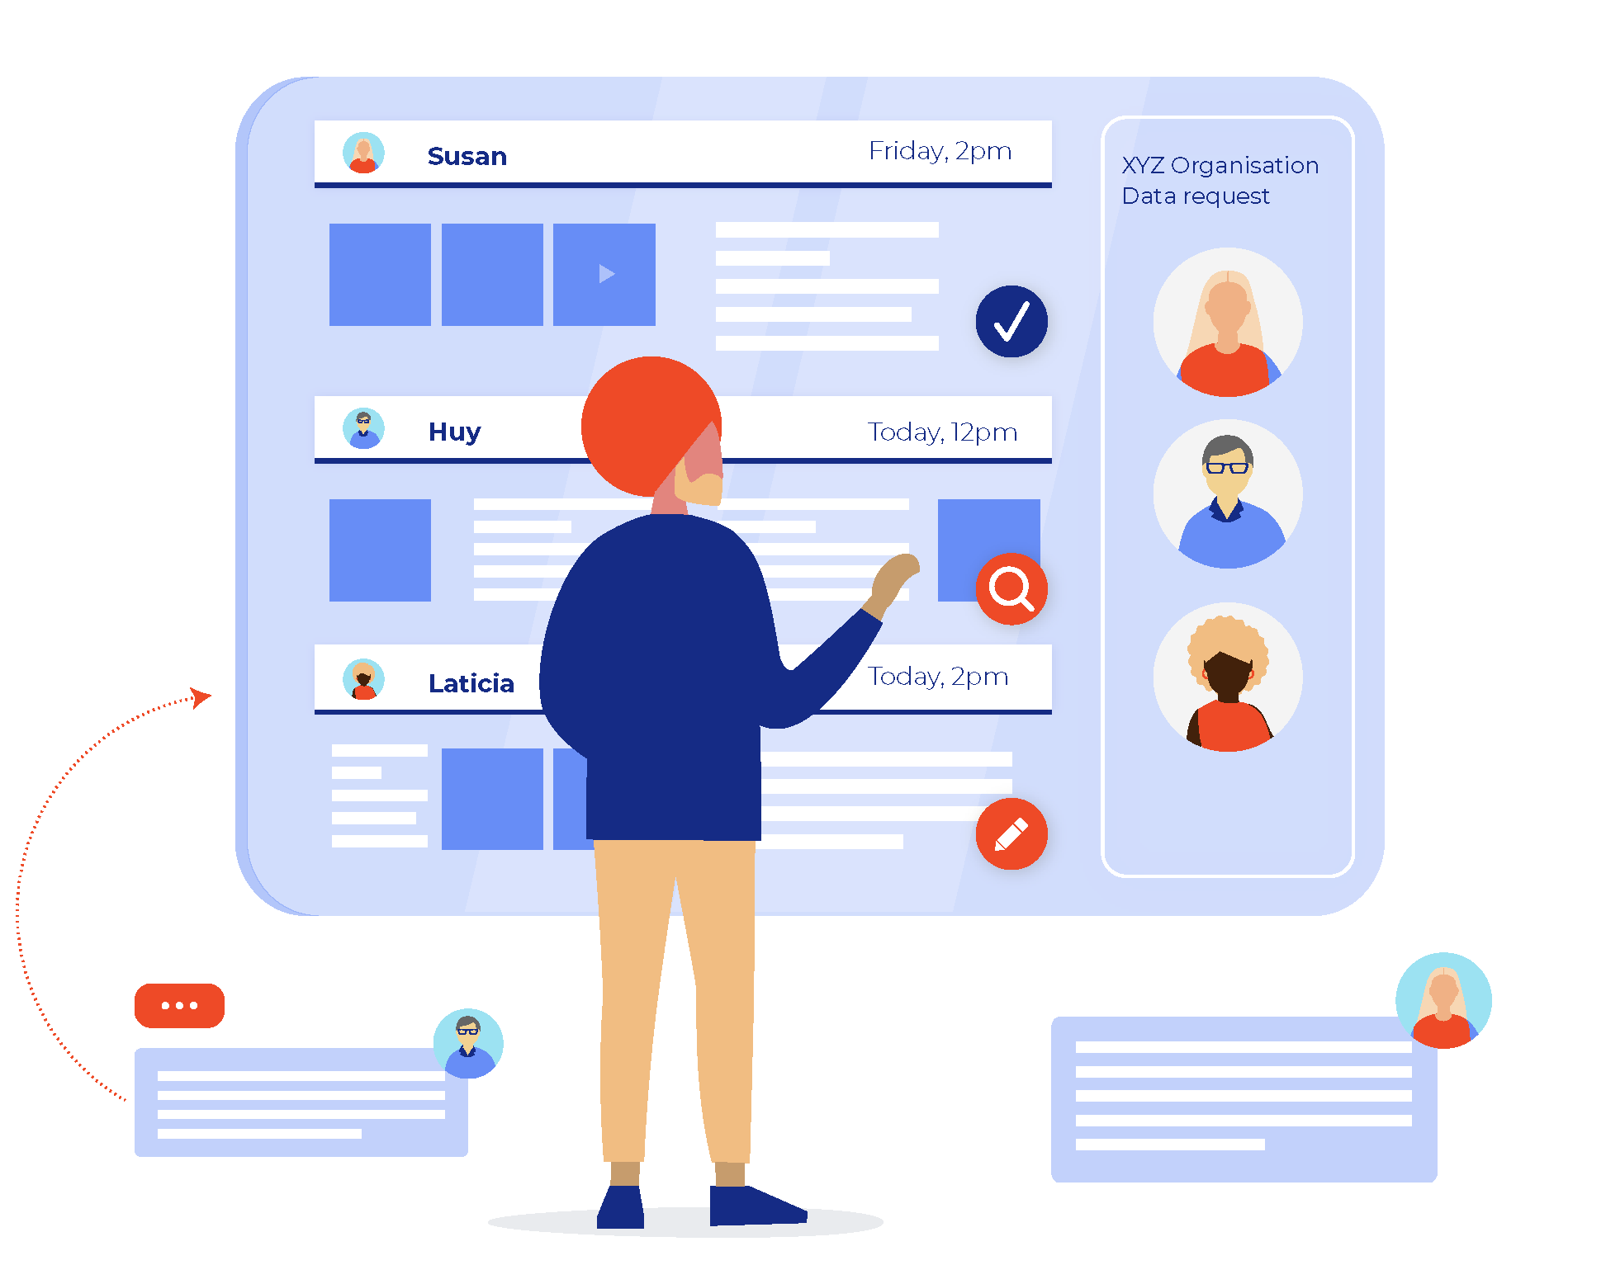
Data in One Place - Dataplace
Data Custodians
Australian Government agencies can upload their data inventories and catalogues
Australian Government agencies can decide whether to make their data open or restricted
When a request to access restricted data is made, Australian Government agencies will work with data users to assess the request.
This assessment will include whether data will be shared under the DATA Scheme (if accredited) or under another legislation
Once assessed and there is in-principle agreement to share data, Australian Government Agencies and Data Users will collaborate on developing a data sharing agreement.
Once the agreement is finalised (and registered by the Data Commissioner for DATA Scheme sharing), data sharing can commence
Data Users
Users will have a one-stop-shop to search, find and request Australian Government data
User can navigate directly to the open source data, or make a request for restricted data through Dataplace
Australian Government Office of the National Data Commissioner | ONDC /

Slide 24
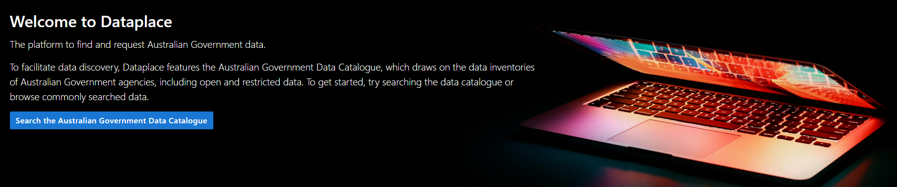
OFFICIAL
Australian Government Data Catalogue
OFFICIAL

Slide 25
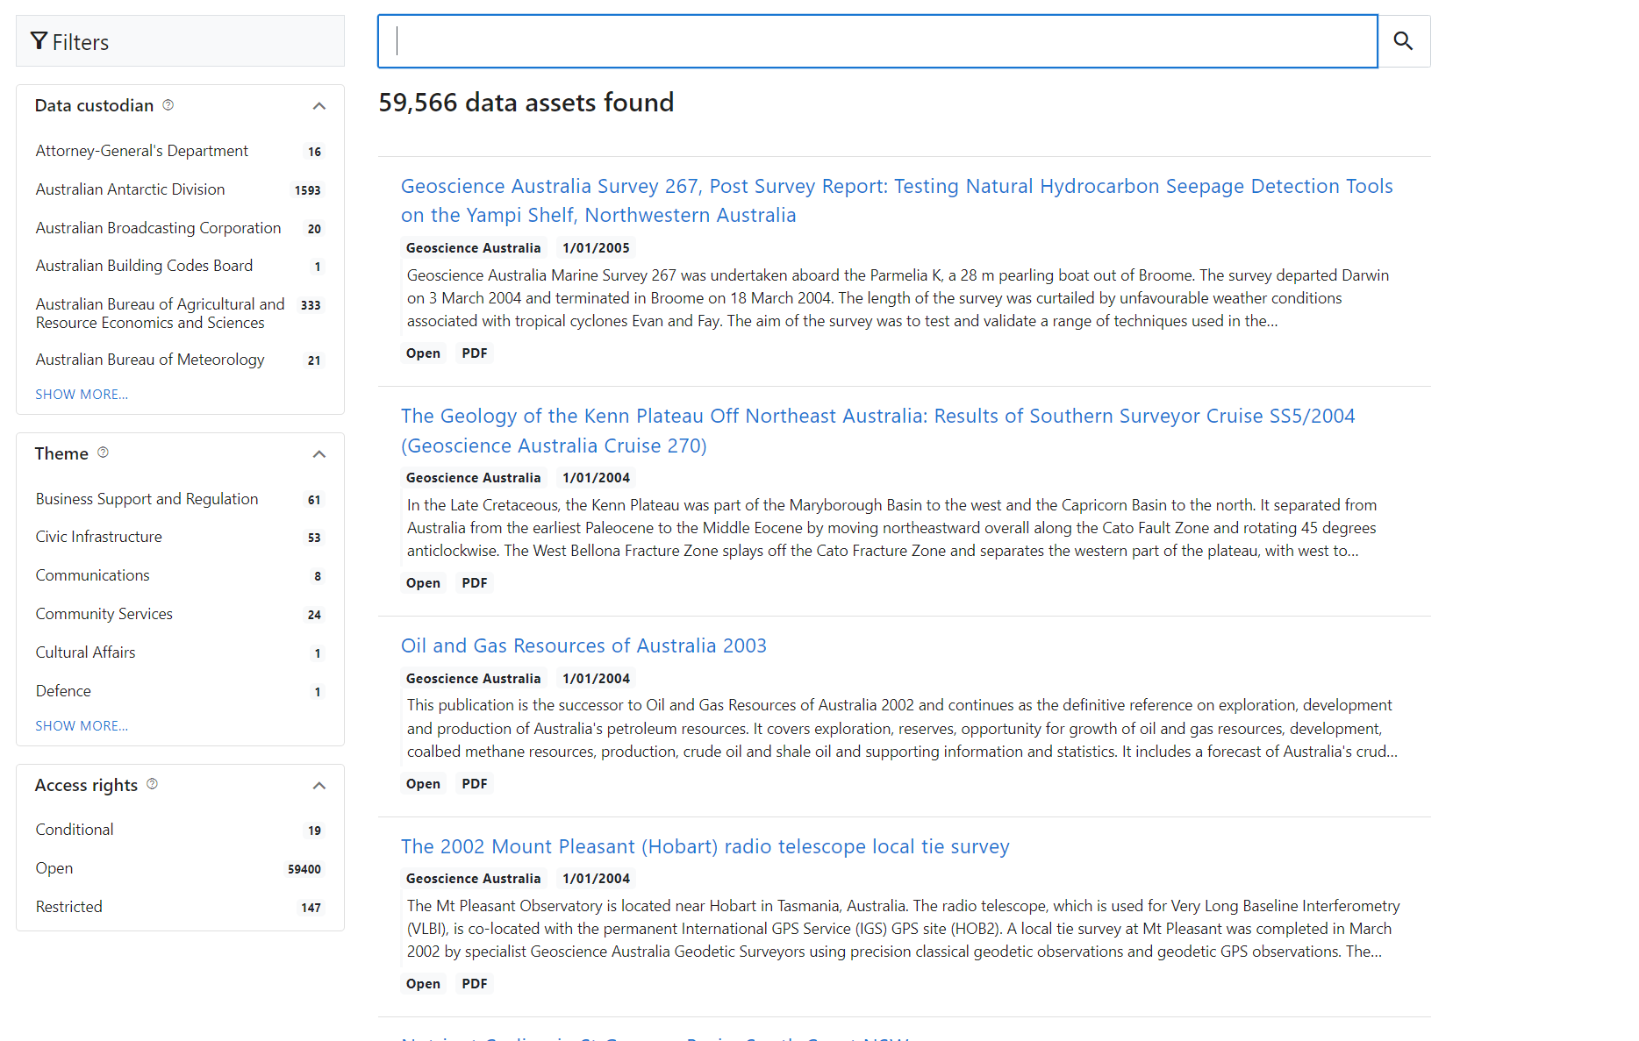

Slide 26
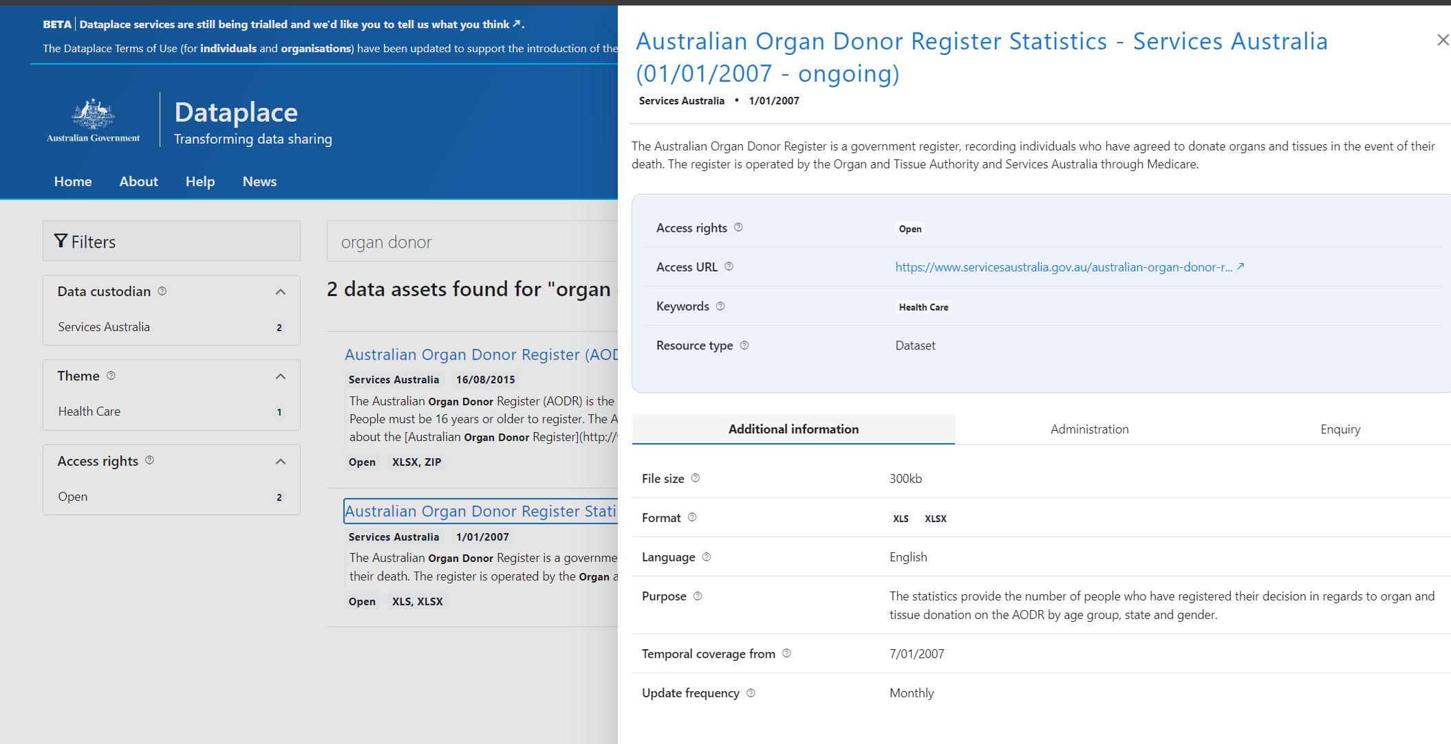

Slide 27
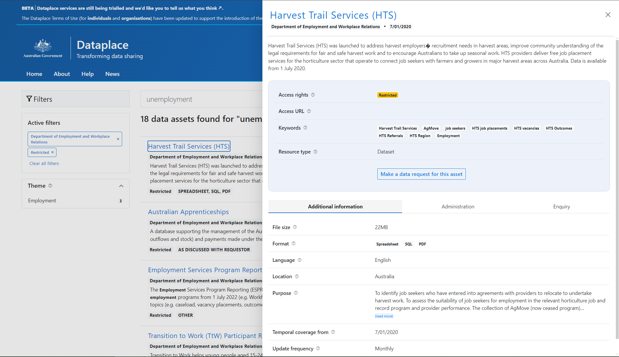

Slide 28
Thank you
Contact us: information@datacommissioner.gov.au

Slide 29
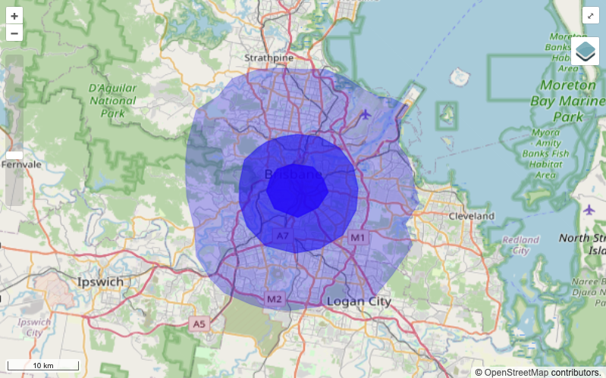
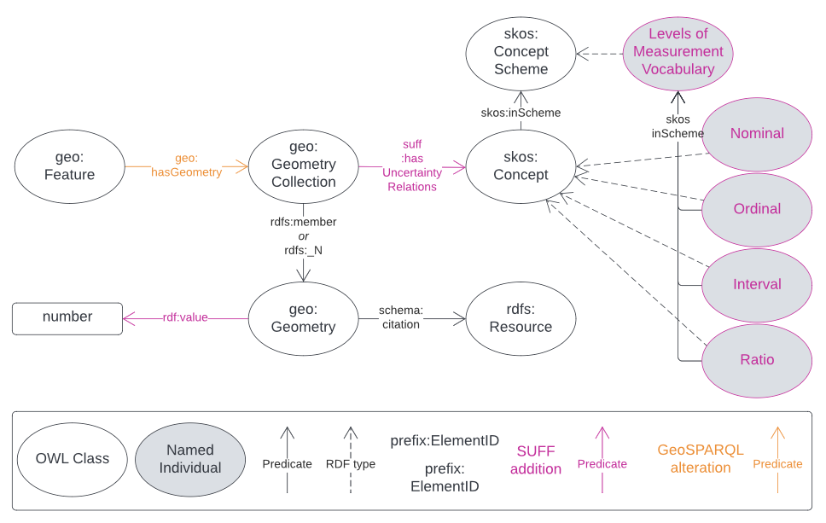
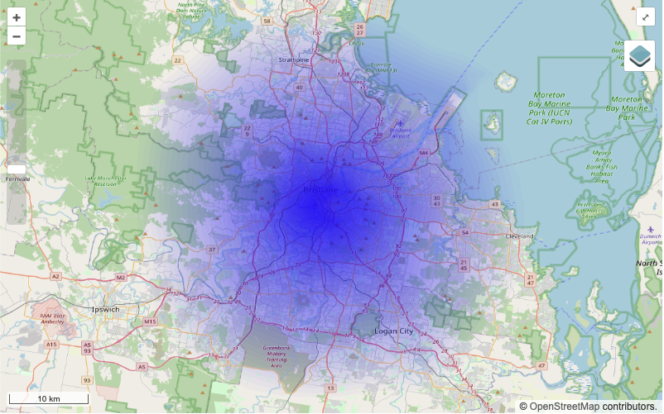
Fuzzy Geometry Model
Speaker: Jamie Feiss, Uni Melbourne
Spatial Uncertainty for Features & Functions (SUFF) Model
A standard way to describe spatial uncertainty in data
Useful for multiple sources of evidence or sensitivity, e.g:
Indigenous homeland areas
Endangered species locations
Will be included in GeoSPARQL 1.3
SUFF JavaScript Implementation
Publicly available JS package
Visualises SUFF RDF as fuzzy gradients
Credit: Nicholas Car https://w3id.org/suff/

Slide 30
ANU First Nations Portfolio
Speaker: Lawson Lewis, KurrawongAI

Slide 31
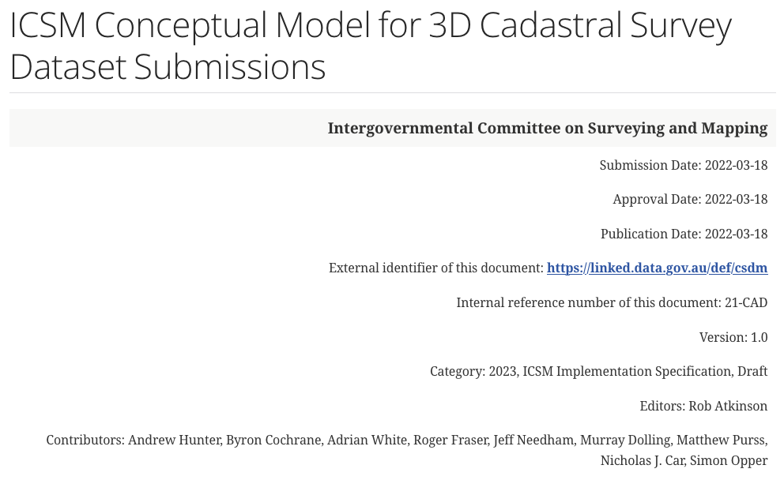
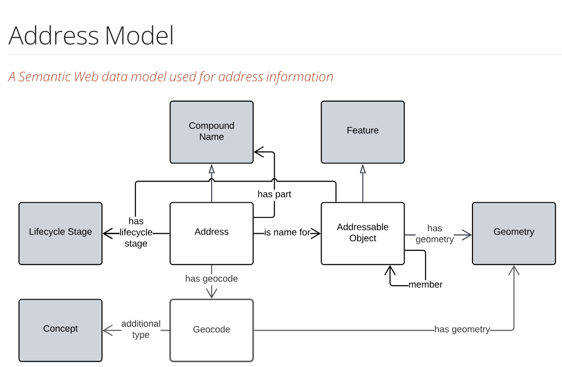
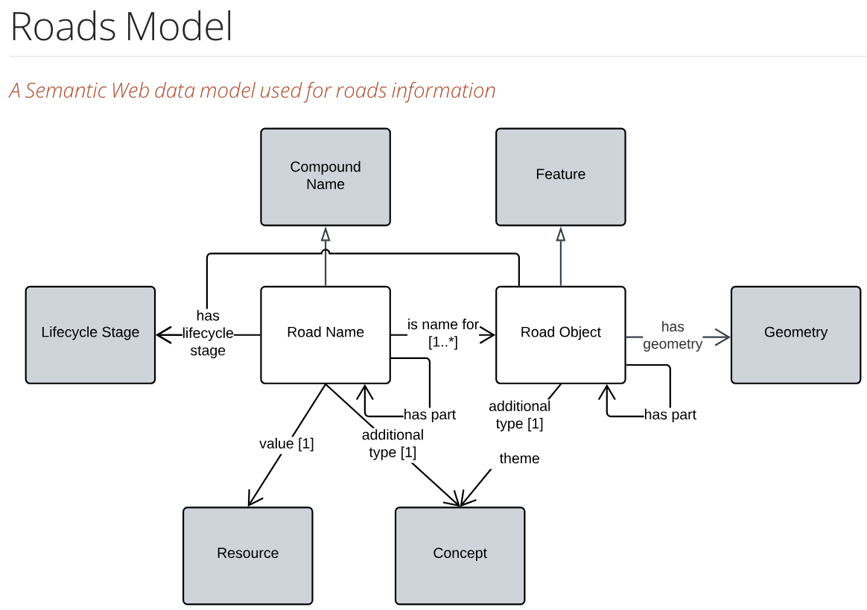

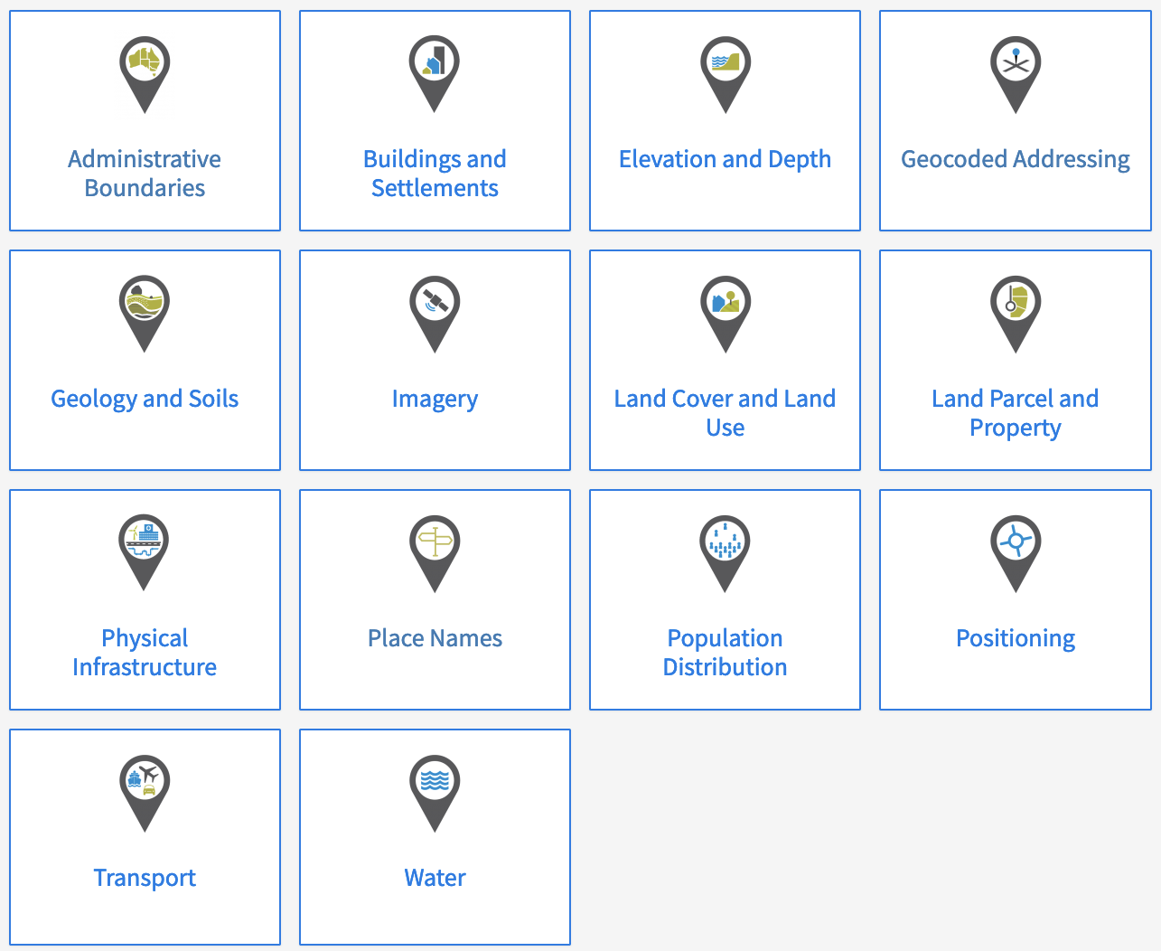
Adoption of national LD
Speaker: Nicholas Car, KurrawongAI

Slide 32
Australian Government Linked Data Working Group contact:
http://www.linked.data.gov.au

